Slide 1
Artwork-Genre Classification
2021 Fall AIP2 Final Project
Hansu Park hansupark@unist.ac.kr
Dahye Jang sweety9764@unist.ac.kr
Jounghyun Kim maxedset@unist.ac.kr

Slide 2

There are a lot of images.
We will build a machine learning model that classifies artworks by the genre.

Slide 3
Problem Settings
Input: Artwork Images
Output: Genre
Goal: Classify the given artwork into the correct genre category
There are 13 artwork categories for the given dataset.

Slide 4
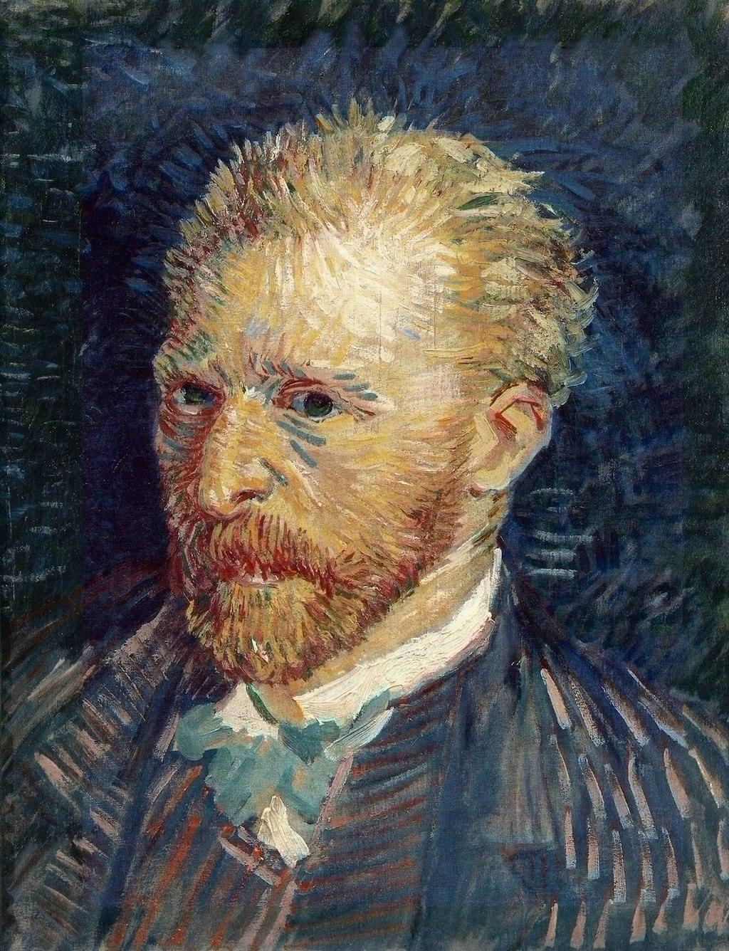
Problem Settings
Post-Impressionism
Input (64x64x3)
Classifier
Output
You should build your powerful classifier.
Try various training skills for better performance!

Slide 5
Download Link
Dataset:
test.npy: https://drive.google.com/file/d/1vcsrvU8KNONpUfR4XwfYXmFfyIH8erwM/view?usp=sharing
train.npy: https://drive.google.com/file/d/1IzMtDWxqcCRvzHukV7HMfLpHGBdtmUjy/view?usp=sharing
Code:
code.ipynb: https://drive.google.com/file/d/1k5kHld01NUYsgeaiv2p7r5MiHb-nDOGM/view?usp=sharing
CodaLab Link:
https://competitions.codalab.org/competitions/36296?secret_key=597561a0-9263-4cfa-9667-372ea0f96221

Slide 6
Datasets
We will provide 2 data sets in this project
Train/Valid Set
Train your model with data samples in the train set.
Validate your model with unused data samples in train set.
Test Set
This is for scoreboard*. You don’t have any label for this set.

Slide 7
Datasets
Train/Valid Set
You can use it as train and validation set.
4573 images, 13 classes(genre) in the train/valid dataset.
Test Set
You can use it for evaluating your model.
1105 images in the test dataset.
We will provide both train/valid dataset and Test dataset as npy file.

Slide 8
Skeleton Code
We provide 1 skeleton code(code.ipynb)
It contains the training part and testing part.
You should fill missing parts in the code to train and test successfully.

Slide 9
Important Notes
You should download 3 files and upload them to your google drive.
3 files → test.npy, train.npy, code.ipynb
Download them through URLs below or in 5 page of ppt.
test.npy: https://drive.google.com/file/d/1vcsrvU8KNONpUfR4XwfYXmFfyIH8erwM/view?usp=sharing
train.npy: https://drive.google.com/file/d/1IzMtDWxqcCRvzHukV7HMfLpHGBdtmUjy/view?usp=sharing
code.ipynb: https://drive.google.com/file/d/1k5kHld01NUYsgeaiv2p7r5MiHb-nDOGM/view?usp=sharing

Slide 10
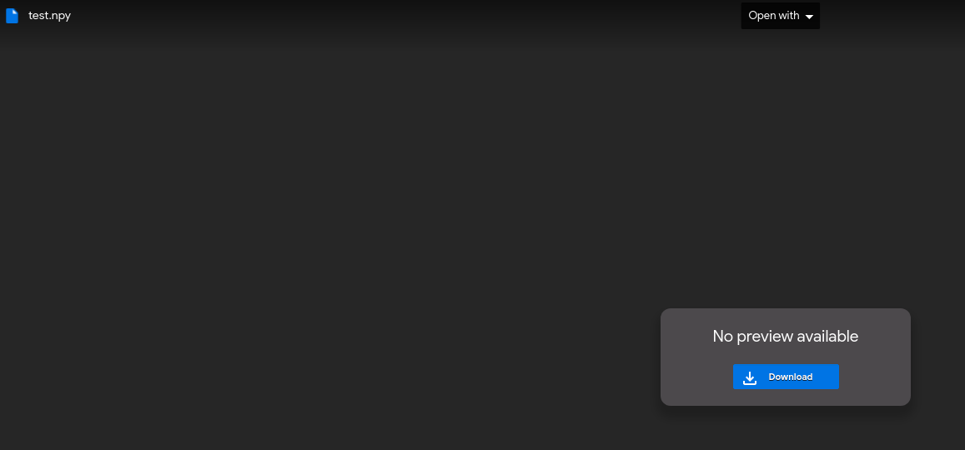
Important Notes
download 3 files

Slide 11
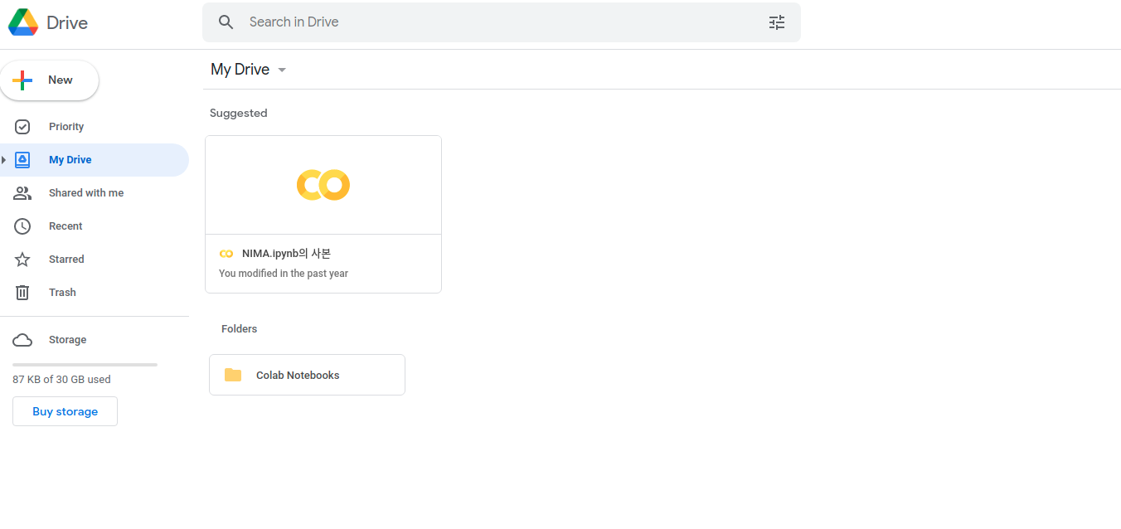
Important Notes
You should upload 3 files downloaded to your own google drive.

Slide 12
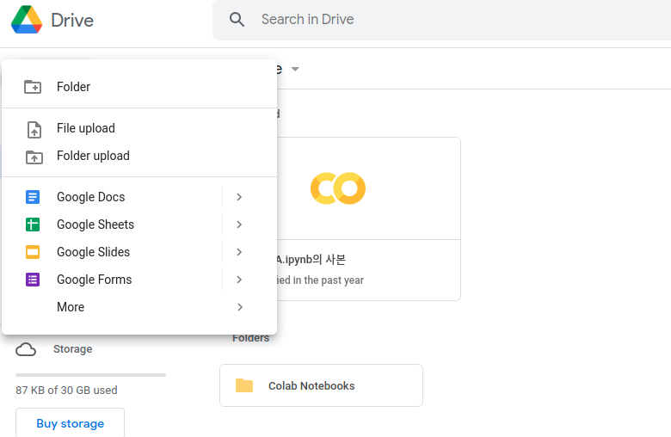
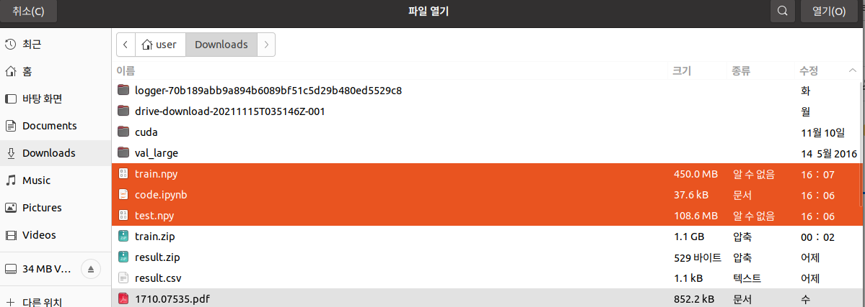
Important Notes
You should upload 3 files downloaded to your own google drive.
Select 3 files(train.npy, test.npy and code.ipynb).

Slide 13
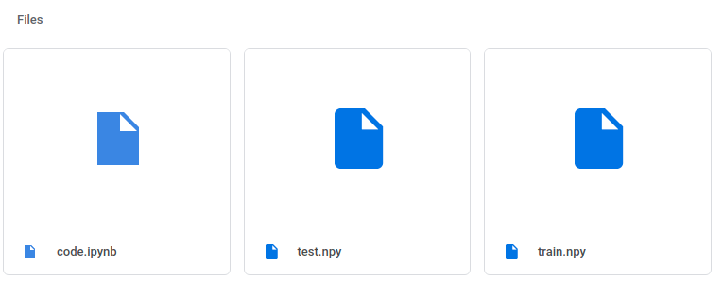
Important Notes
train.npy and test.npy are the dataset we will use.
code.ipynb is our skeleton code.

Slide 14
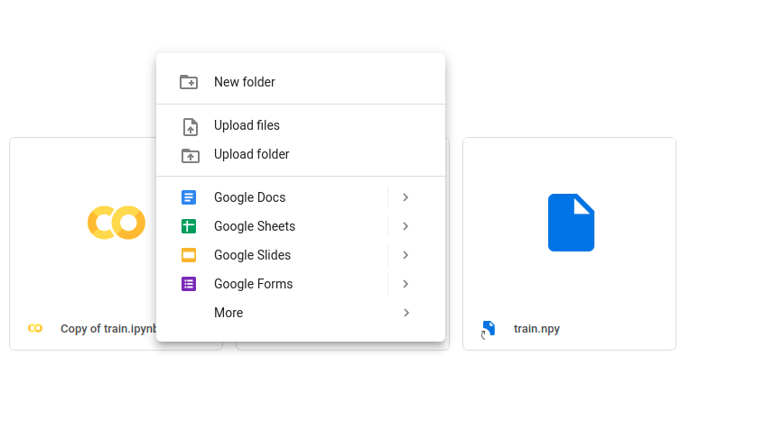
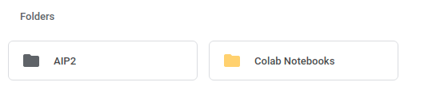
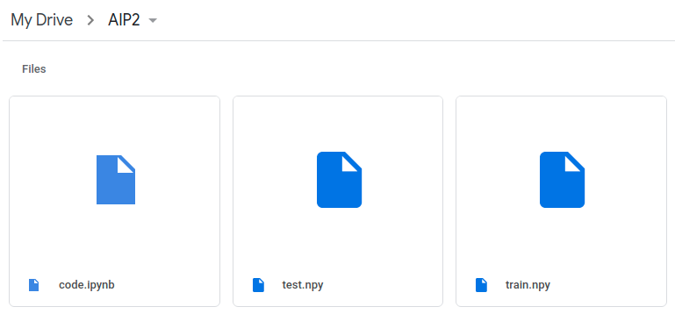
Important Notes
Make a folder to contain 3 files and move them into the folder.

Slide 15
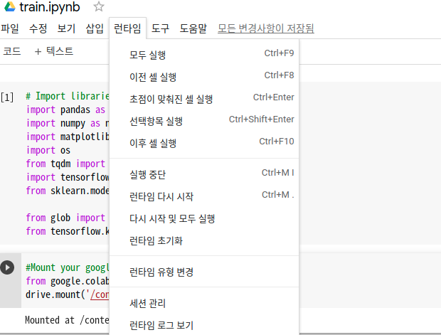
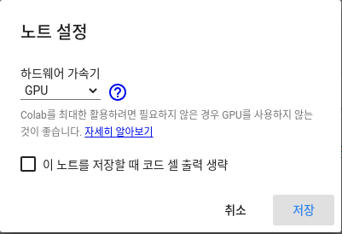
Code
Change the type of runtime from ‘None’ to ‘GPU’.

Slide 16
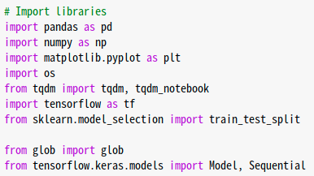
Code
Some libraries already imported.
And you can import other libraries if you want

Slide 17
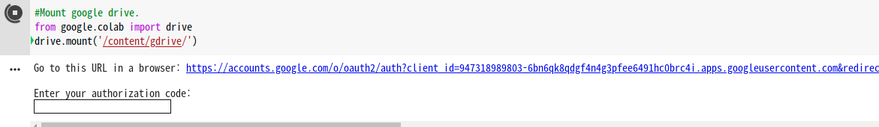
Code
You should enter the code into blank to mount your google drive on Colab.
Click the URL above.

Slide 18
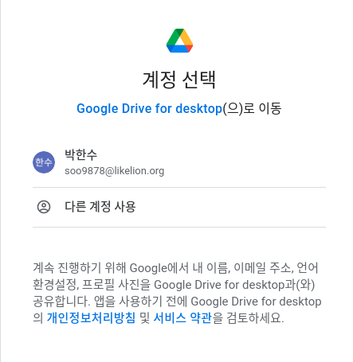
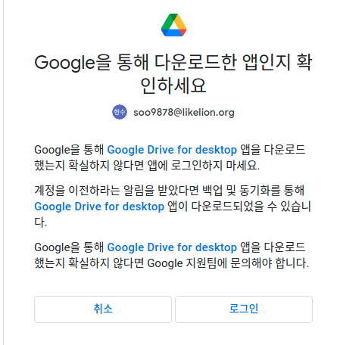
Code

Slide 19
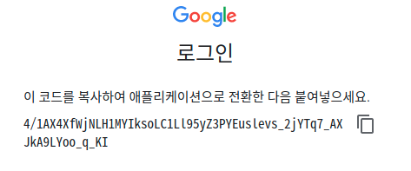
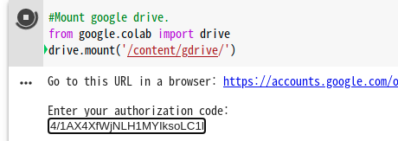
Code
Copy
Paste

Slide 20
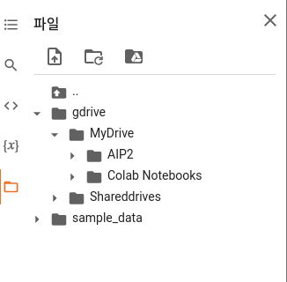
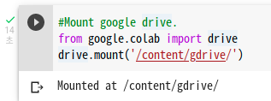
Code
You can see your google drive in the Colab.

Slide 21
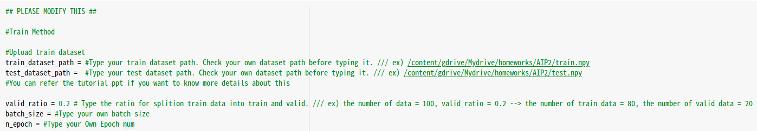
Code
You should modify this part according to your environment(train_dataset_path, test_dataset_path) and hyperparameters(valid ratio, batch_size and n_epoch).

Slide 22
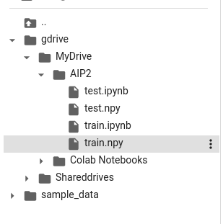
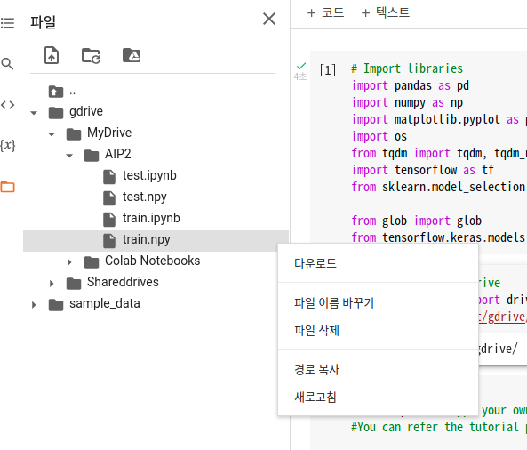
Code
You can get your dataset path as followed above.

Slide 23
Code
Paste your path at the red blank.

Slide 24
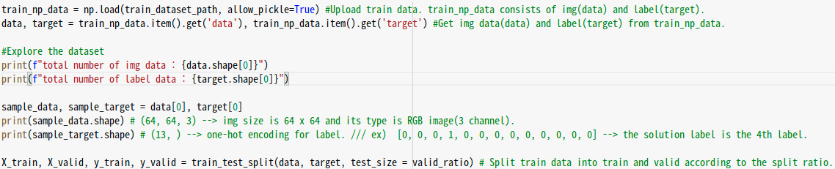
Code
This part is for loading the train dataset.

Slide 25

Code
If your dataset was successfully uploaded into the Colab, you can see the picture above.

Slide 26
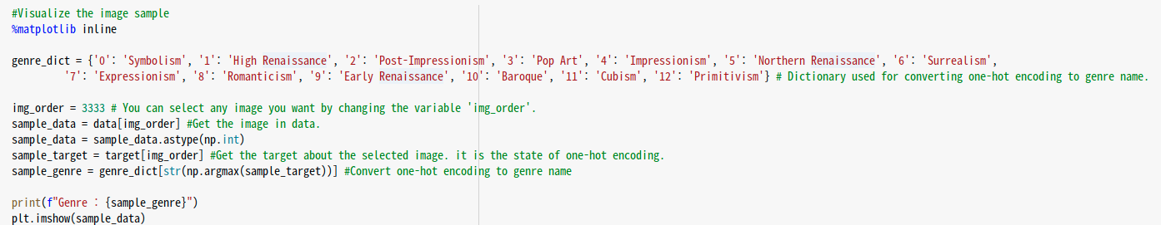
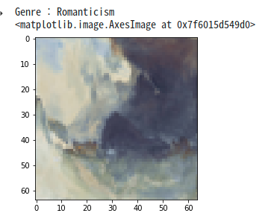
Code
This is the part for visualizing the image in the colab.
You can visualize another image by changing the value of variable ‘img_order’

Slide 27
Code
You can split the dataset into train and valid according to valid_ratio. For example, dataset is splitted into 80% train dataset and 20% valid dataset by setting the value of valid_ratio to 0.2.

Slide 28
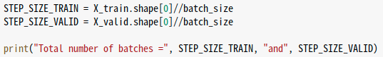
Code
STEP_SIZE is decided by batch_size.

Slide 29
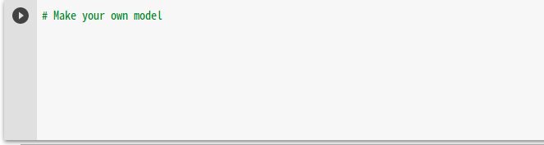
Code
Build your own model for image classification.
Be careful your session can be closed if you set the high value of epoch.
Refer the below site to maintain your session despite of high epoch num.
https://naenjun.tistory.com/18

Slide 30
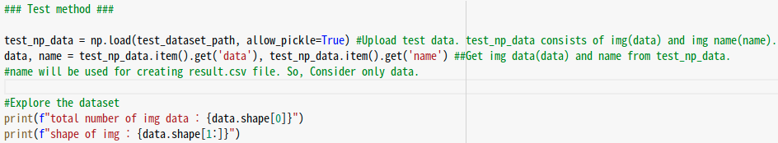
Code
This part is for loading the test dataset.

Slide 31

Code
If your dataset was successfully uploaded into the Colab, you can see the picture above.

Slide 32
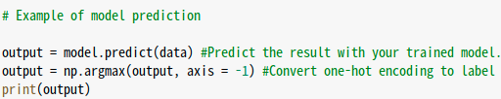
Code
You can predict the result of test dataset with your trained model.

Slide 33
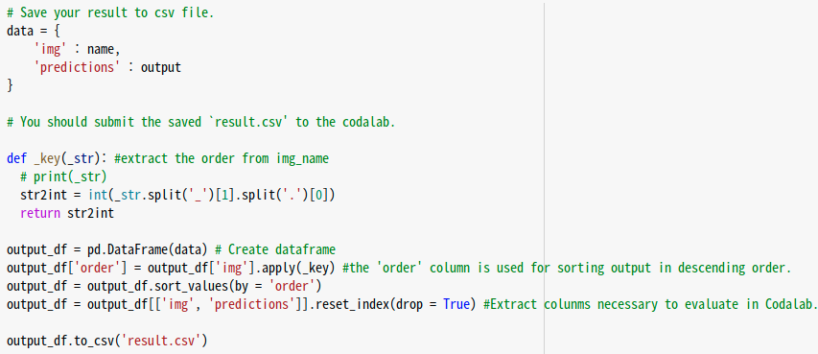
Code
This part is for generating your result in csv file.
You must not modify column names and csv file name when you submit to the scoreboard.

Slide 34

Scoreboard
You can submit your result csv file to our scoreboard system “CodaLab” to evaluate your model.

Slide 35
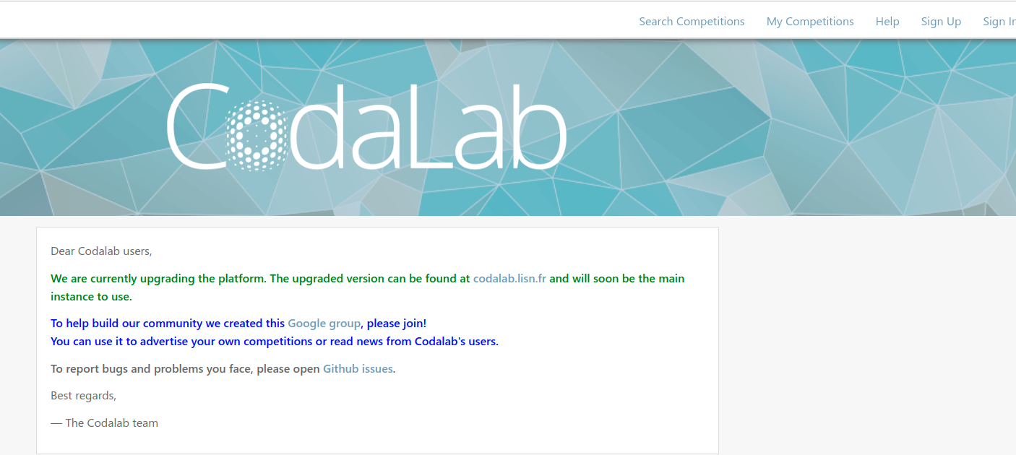
Scoreboard
You have to sign up in the Codalab.

Slide 36
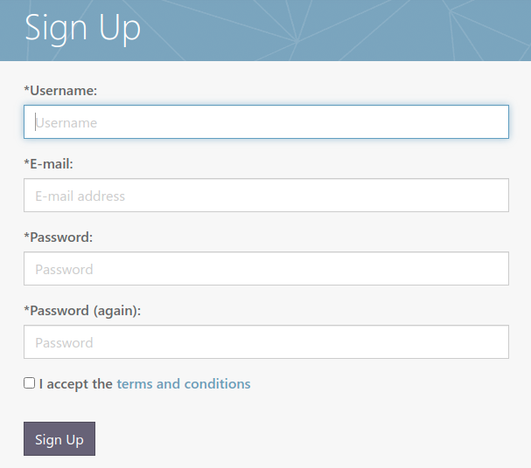
Scoreboard
You should name your username ‘unist_aip2_studentnum’.
ex> unist_aip2_2021xxxx

Slide 37
Scoreboard
After signing up, sign in with your account.

Slide 38
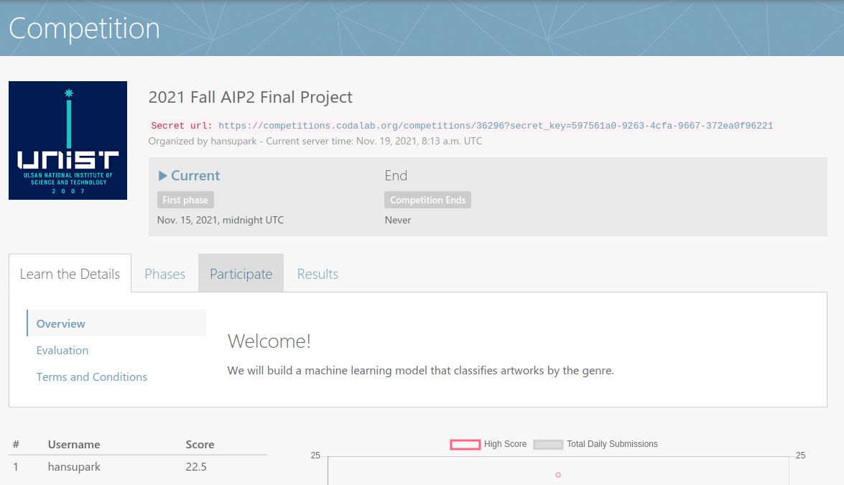
Scoreboard
Enter our competition website with URL below.
https://competitions.codalab.org/competitions/36296?secret_key=597561a0-9263-4cfa-9667-372ea0f96221

Slide 39
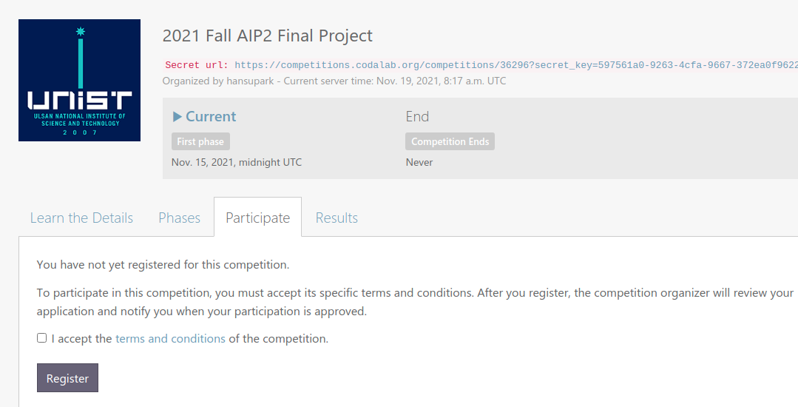
Scoreboard
You should register for our competition.
Click the Register button.

Slide 40
Scoreboard
As previously explained, this part generates the result csv file containing your output of test dataset.

Slide 41
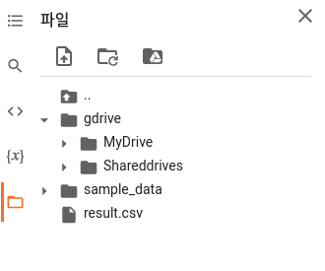
Scoreboard
If you execute the cell generating result csv file, you can have the csv file ‘result.csv’ in the colab.

Slide 42
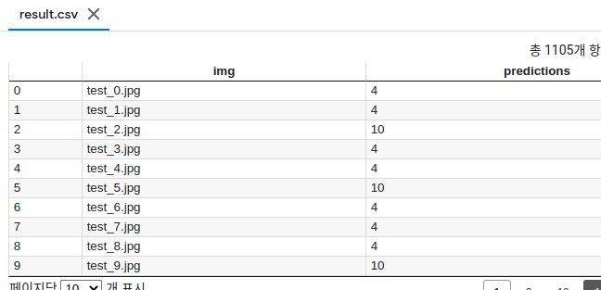
Scoreboard
You can see your csv file by clicking the file in twice.

Slide 43
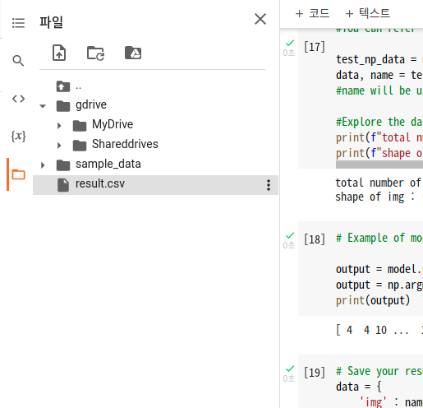
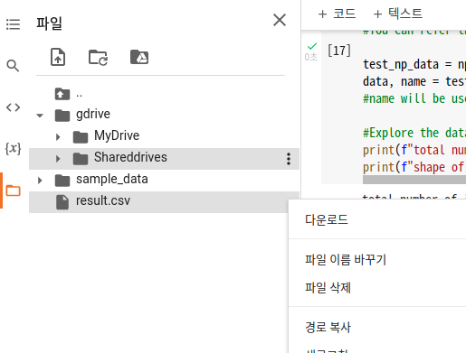
Scoreboard
Download your result.csv file in the colab.

Slide 44
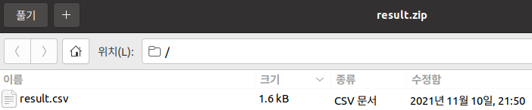
Scoreboard
Compress your result.csv with zip format and name it ‘result.zip’

Slide 45
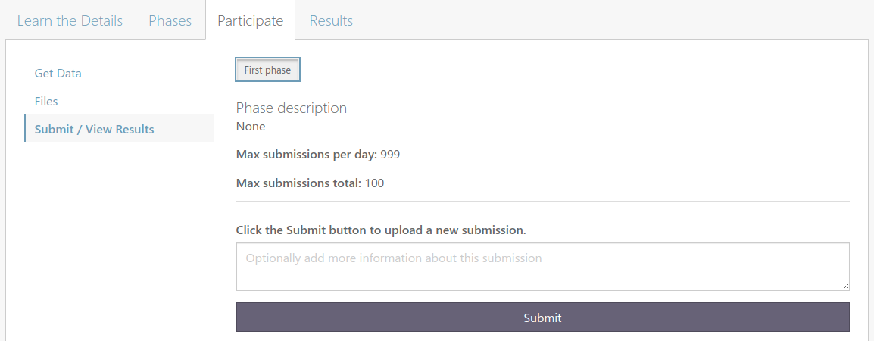
Scoreboard
You can submit result.zip in above page.
Click the Submit button.

Slide 46
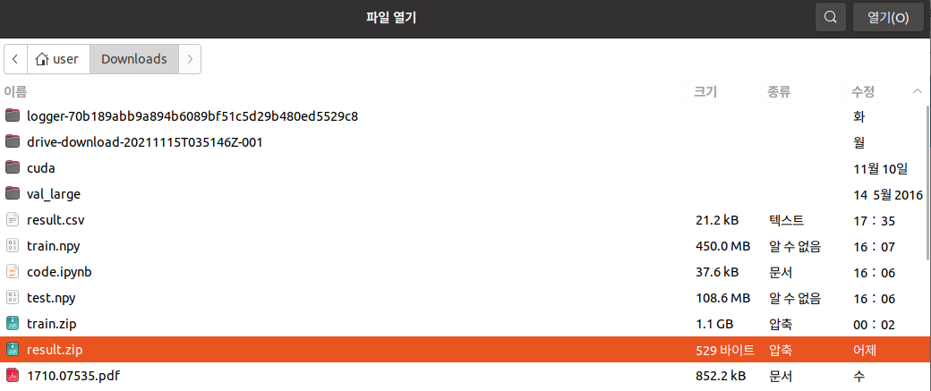
Scoreboard
Select your result.zip.

Slide 47
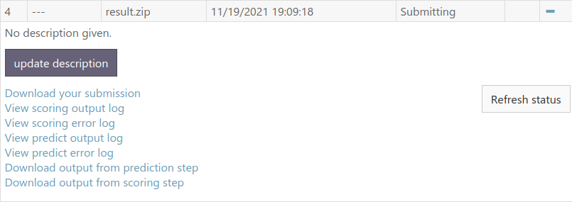
Scoreboard
You can check your status of submission by clicking the ‘Refresh status’ button.

Slide 48
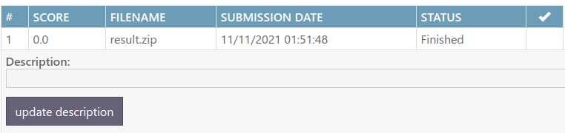
Scoreboard
If your submission was successfully processed, the status of submission will be ‘Finished’.

Slide 49
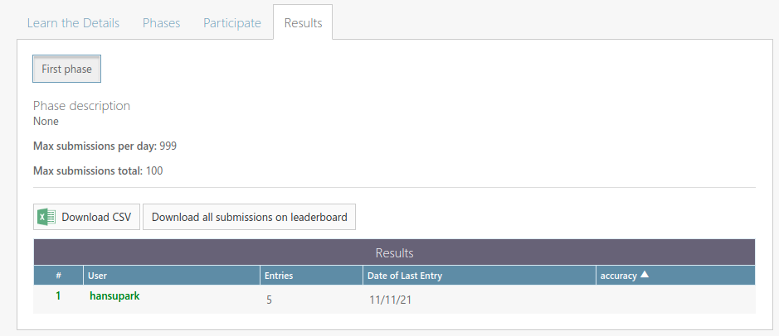
Scoreboard
You can check your ranking in the scoreboard.

Slide 50

Important Notes
your student number
You need to submit to the codalab system at least once and capture/paste the result table with your ID visible.
Please make sure your ID is unist_aip_#studentnumber.

Slide 51
Report 70% Performance 30%
Evaluation Criteria

Slide 52
Contents of Report
Model Description
Please provide layer-by layer description of your model. Be precise as far as you can.
Training
Specify all details of your training scheme including optimizer, #of epochs, learning rate scheduling, regularization, data augmentation, etc.
Please specify the reason why you adopt such training techniques and select hyper-parameters (as far as you can)
Performance Evaluation
Show your training, validation and test accuracies
Analysis
Include any ablation studies* for your choices such as model architecture, hyperparameters, any techniques you need.
Any meaningful analysis or explanations for your results.
*Ablation study means any additional experiments that verify your choices in your project.
For example, if you chose ADAM optimizer because it gives better performance than SGD or RMSprop
Then you should show the worse results of SGD and RMSprop cases to verify your choice of ADAM optimizer.

Slide 53
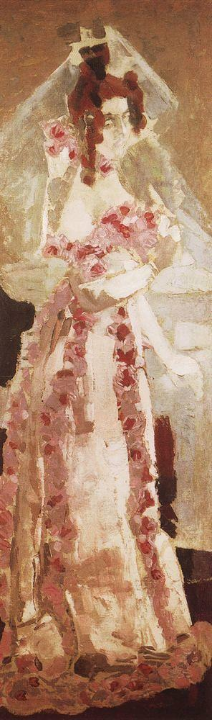
What is the purpose of writing reports?
You should write a report that fully explains your model in detail. Based on the report, other researchers can reproduce your results.
We know that it may be the first time to write a research project report, but try to write concrete reports as possible as you can. We will evaluate your all efforts.

Slide 54
Report 70% Performance 30%
Evaluation Criteria

Slide 55
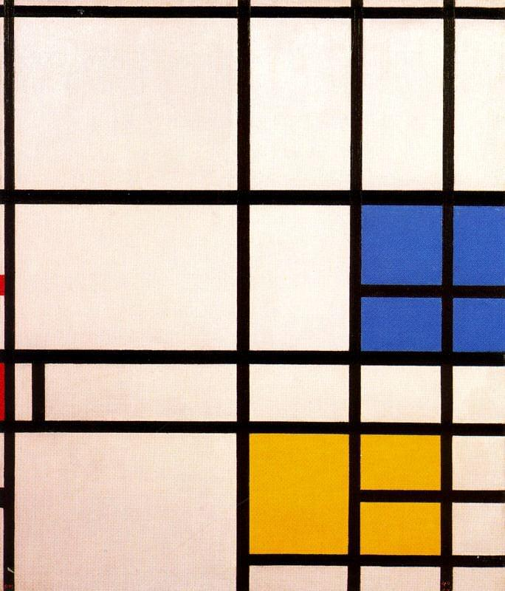
The model performance will be graded with the ACCURACY on the test dataset.
Performance

Slide 56

Performance
Accuracy – You need to report the accuracy of your model from the CodaLab system.

Slide 57
Submission Form
SUBMIT 1 ipython notebook file, 1 output file and 1 report file via Blackboard
Your file names should be as follow (replace 20210000 to your student ID)
AIP2_20210000_code.ipynb
20210000_result.csv
The result.csv file is the output file obtained from AIP_20210000_code.ipynb.
When submitting it to the Blackboard, rename it ‘20210000_result.csv’. I recommend copying result.csv file and renaming the copy file.
20210000_report ( doc(docx) or hwp file)

Slide 58
Important Notes
DO NOT COPY any other codes (from colleagues or web)
DO NOT SHARE trained parameters of your model with other colleagues.
DO NOT LOAD pre-trained weights of model
it is prohibited to load already-trained models (e.g, ImageNet pretaining)
But you can do your own pretraining: It is allowed to WRITE YOUR OWN PRETRAINING code, and PRETRAIN your model, and UTILIZE the model for this project.
You will DEFFINITELY GET 0 POINT
when you violate these rules.

Slide 59
Important Notes
For example, when you loads architecture and pretrained ResNet from ImageNet, this would be considered as plagiarism.
But it does not mean that you cannot use any popular architecture such as ResNet.
You can use popular architectures only with your own layer-by-layer implementation.

Slide 60
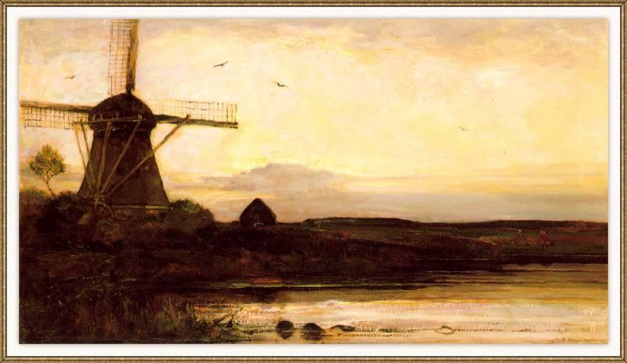
Submission & Important Dates
What to submit: 1 ipynb file, 1 result.csv file and 1 report
Where to submit: on BB assignment (as other lab assignments)
Final Project Tutorial Session: 2021-11-24 (Wen.) & 25(Thu) regular lecture/lab sessions
Due date for submission: 2021-12-17 (Fri.) 23:59
Claim Period: 2021-12-21 (Tue.) ~ 12-23 (Thurs.)

Slide 61
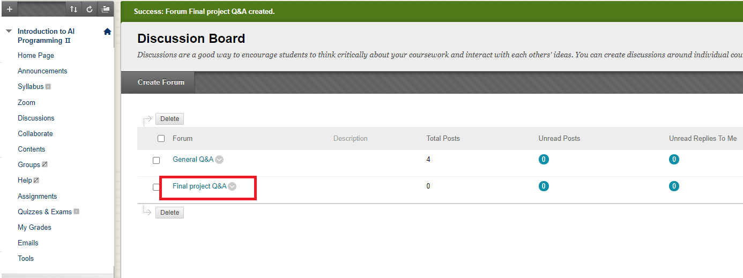
Q&A

